Slide 1


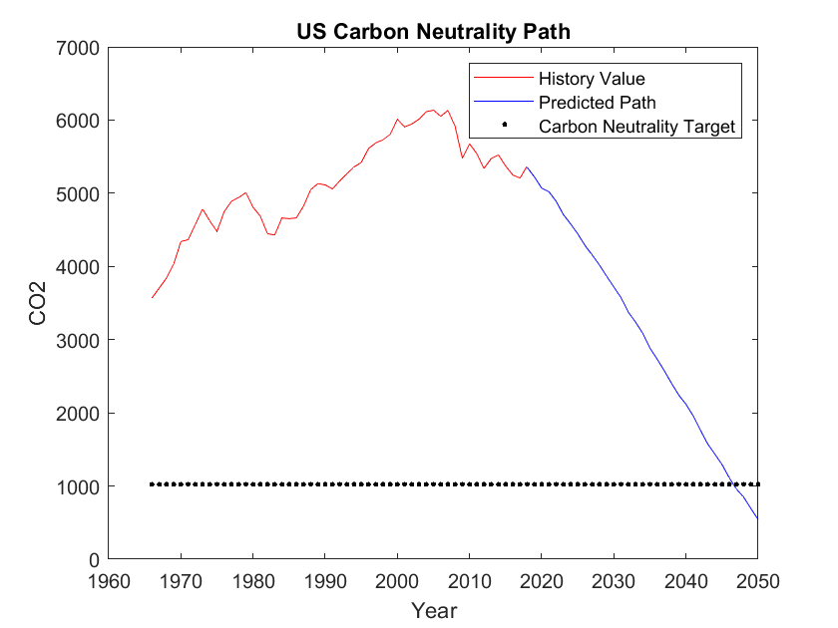
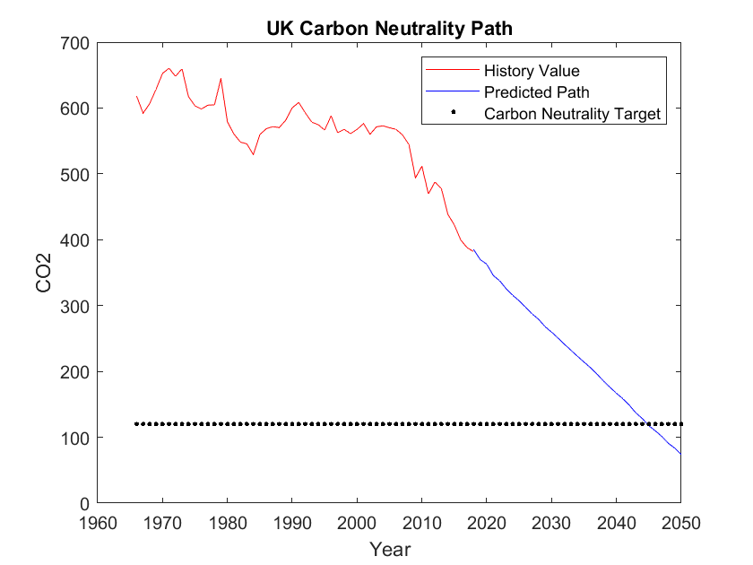
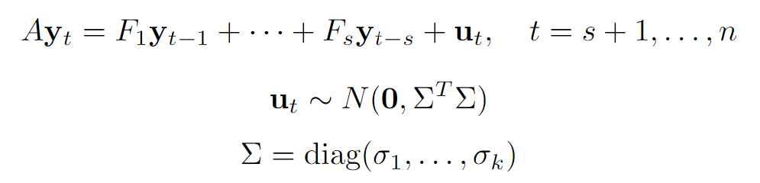
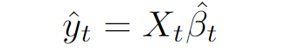
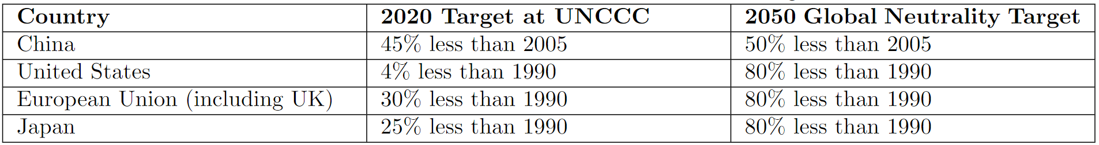
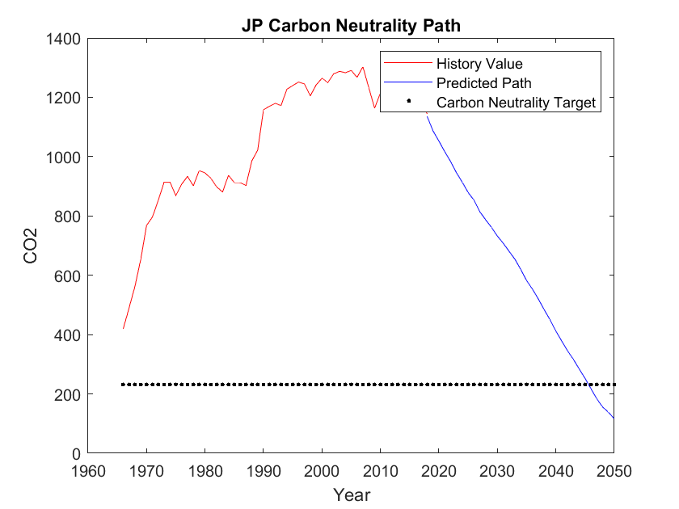
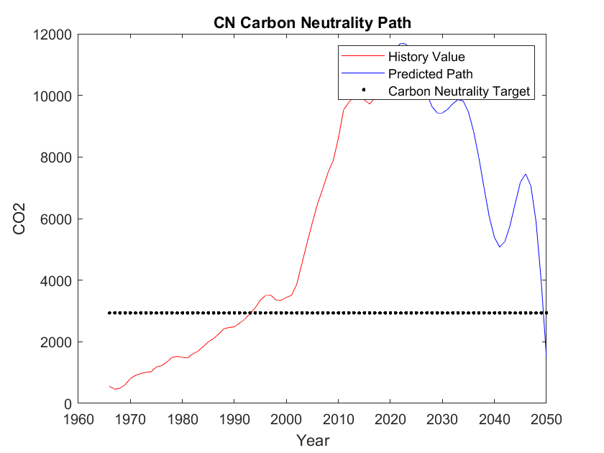
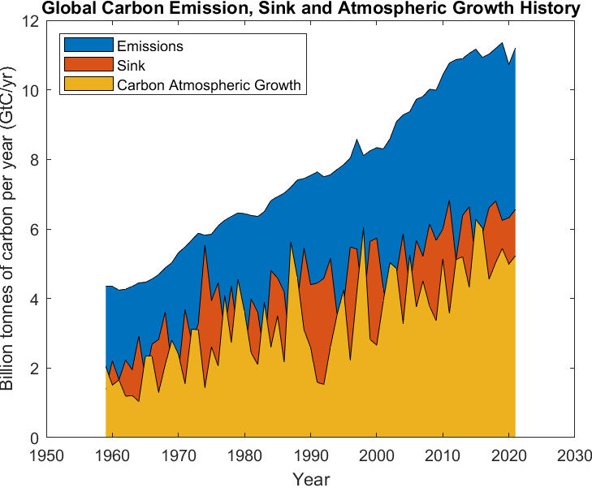
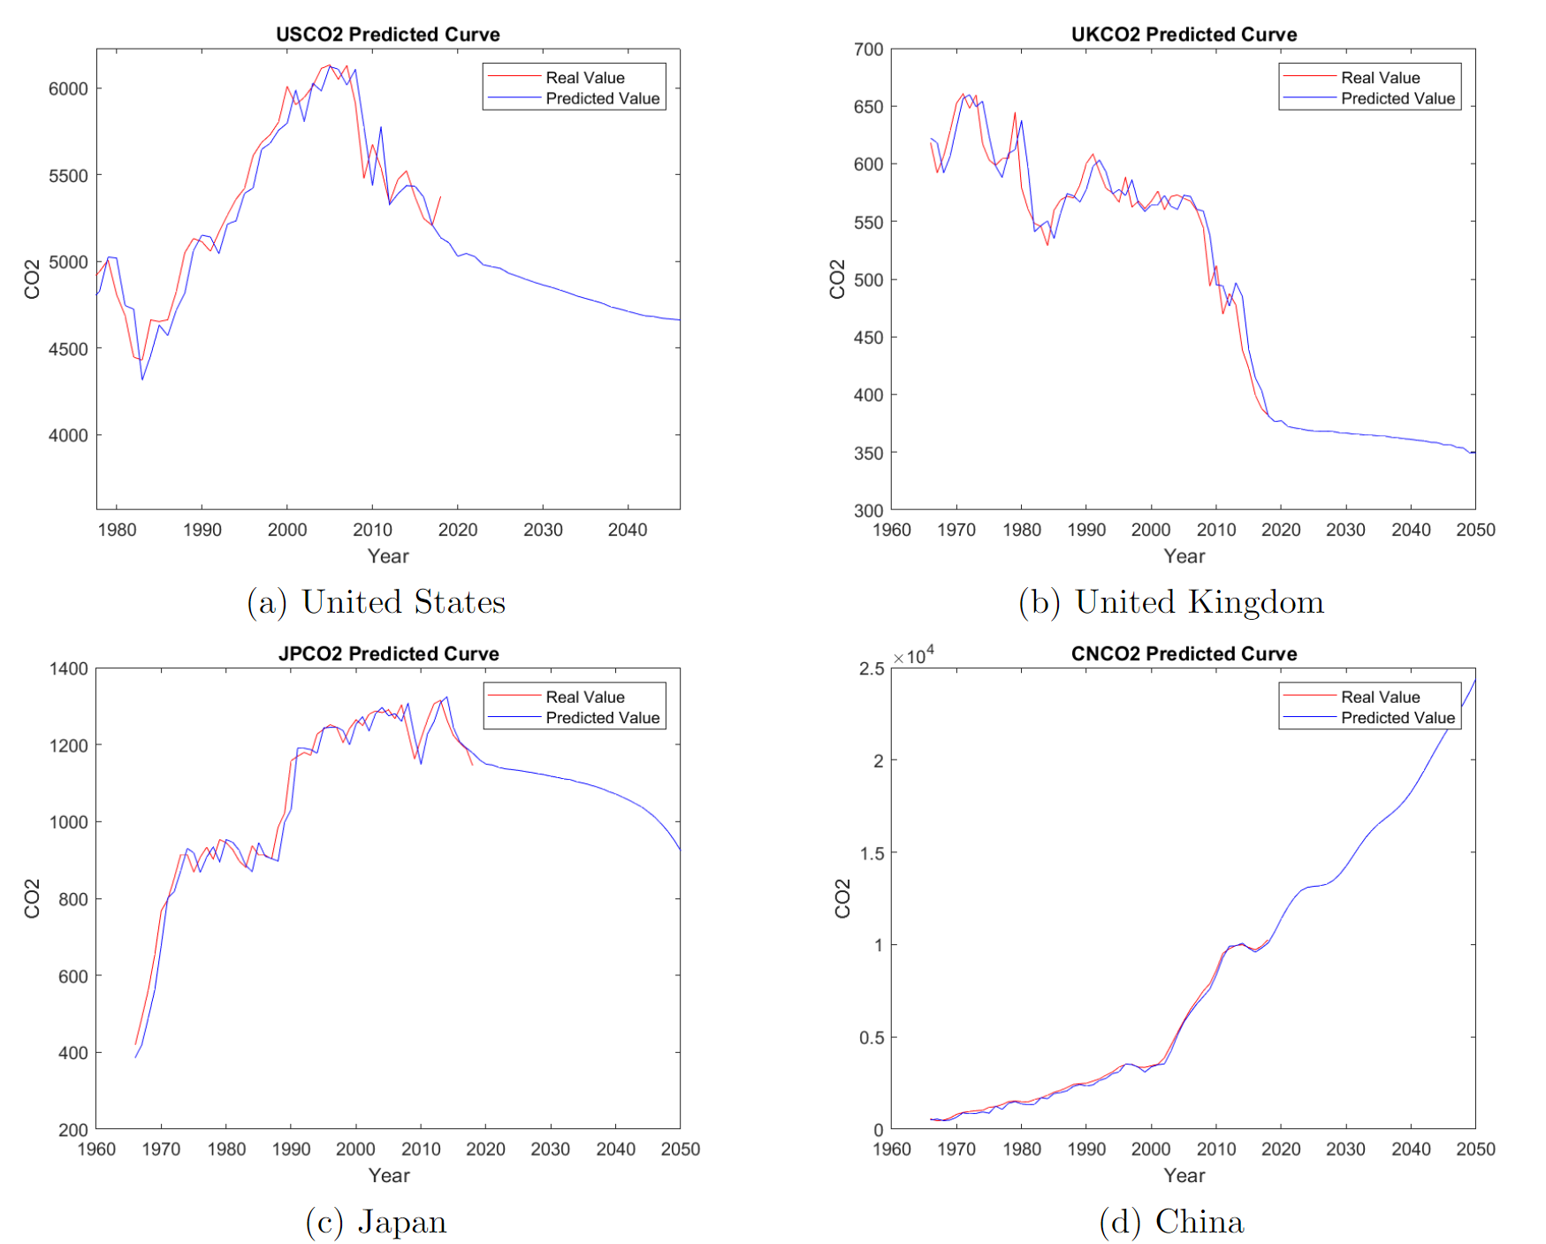
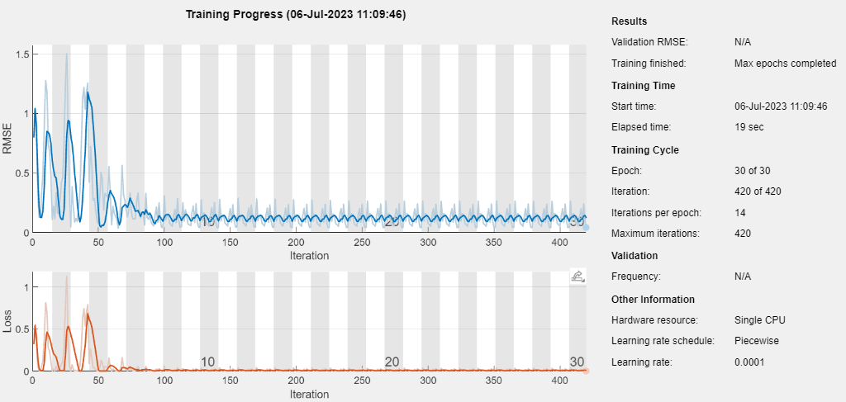
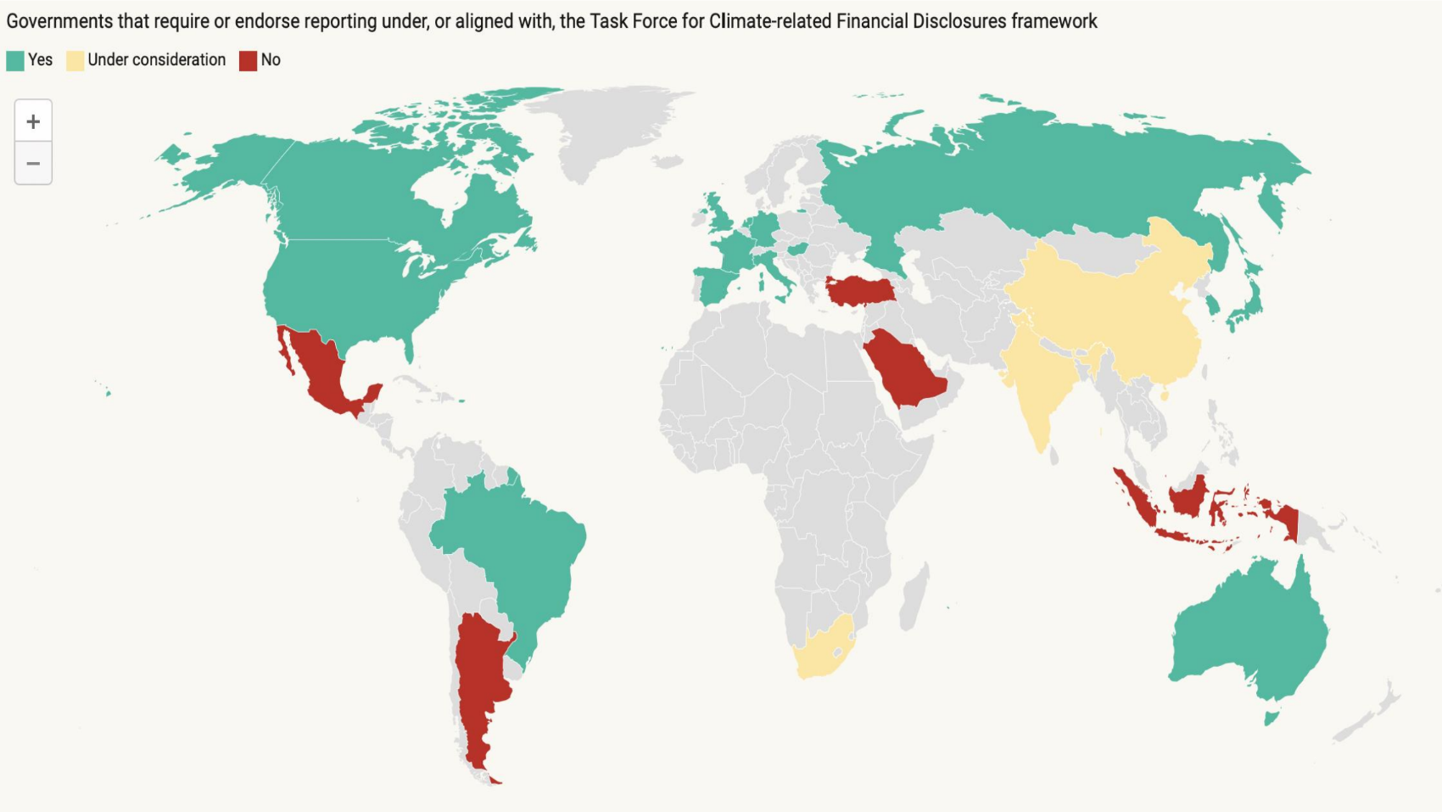
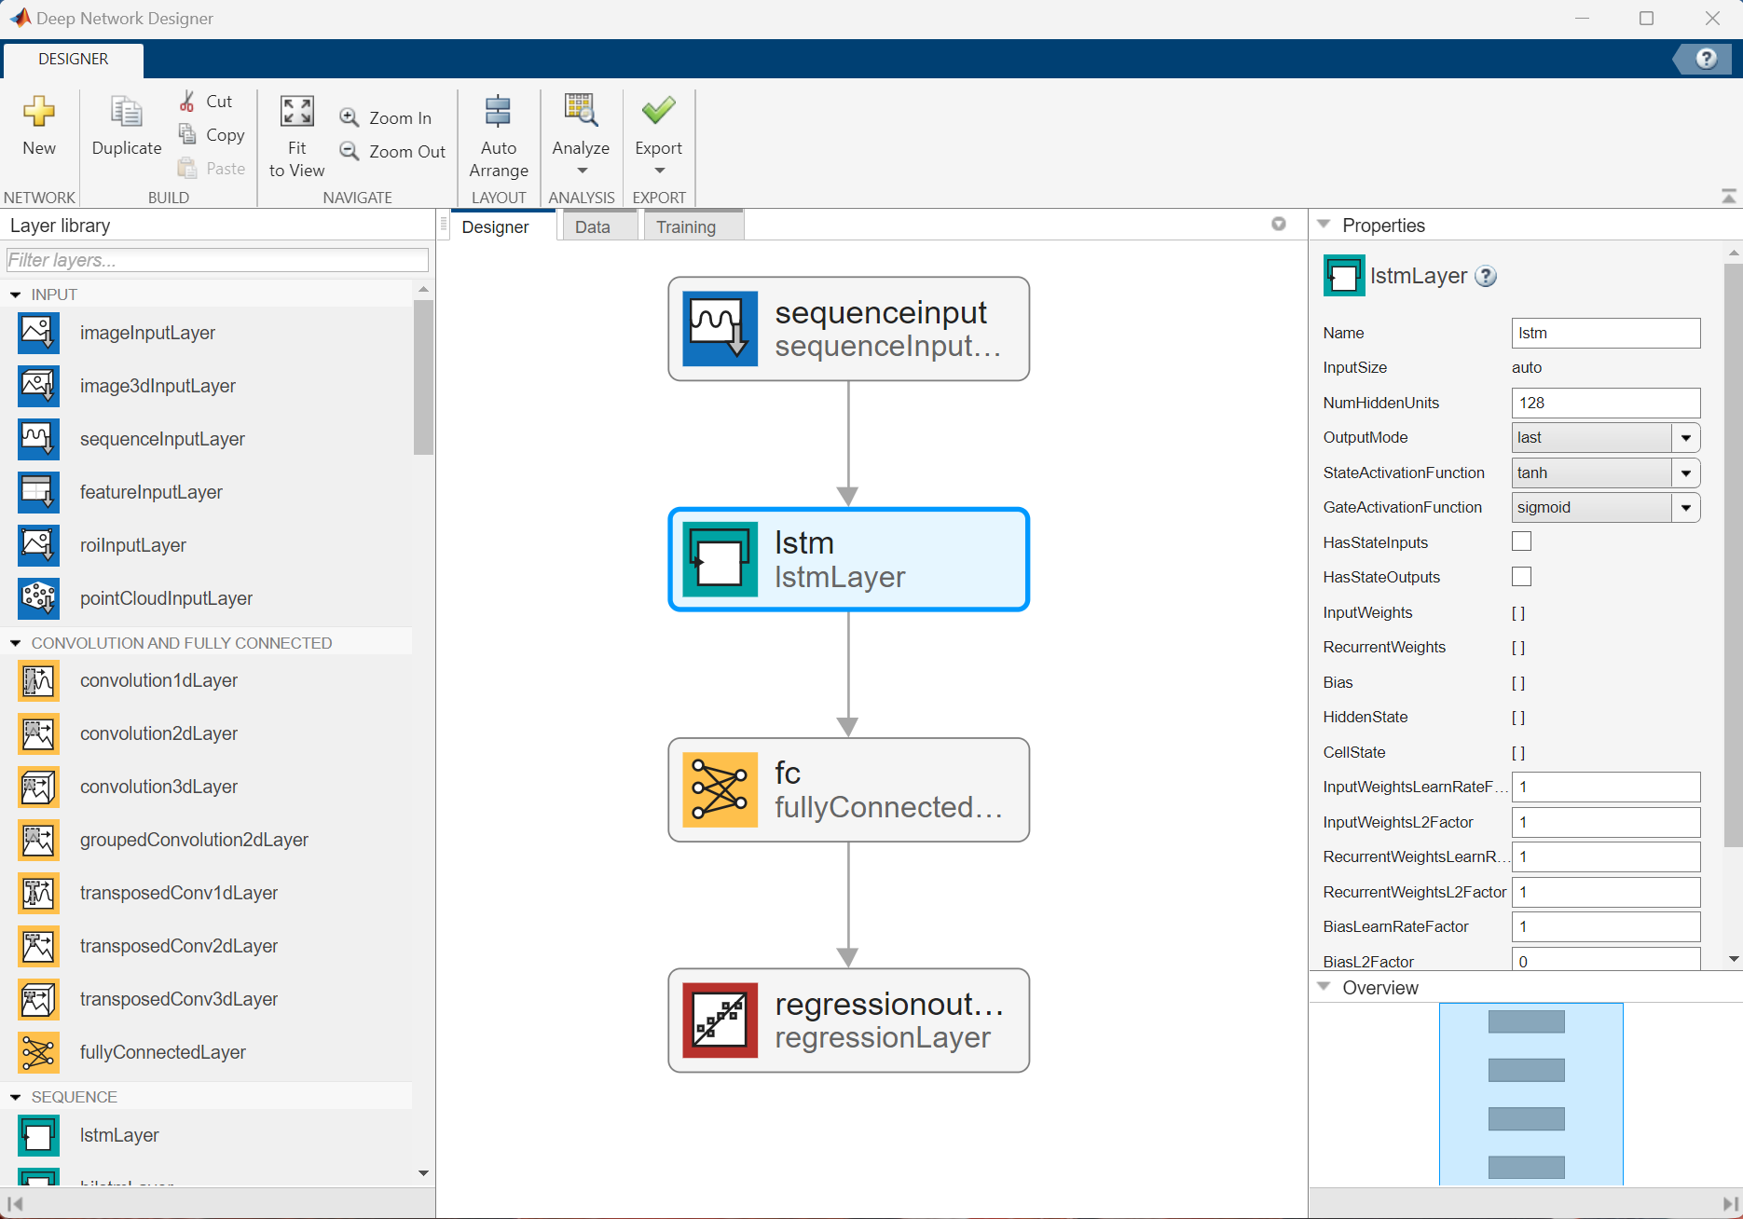


The Path to Carbon Neutrality: A Time Series Approach
Haoran Zhang^{1,2}, Yuchen Dong¹
¹The MathWorks Inc., ²Northeastern University
2nd LOGO
INTRODUCTION
METHODS
RESULTS
Carbon neutrality is the United Nation’s most urgent mission, but lack of data, evaluation criteria and techniques presents a challenge. The global energy crisis because of COVID-19 and Ukraine War has complicated carbon emission data analysis. Policymakers have failed to meet established carbon reduction goals.
We adopt CO2 emission and sink data released in November 2022 and introduce new models to recalculate path.
Use Time-Varying Parameter Vector Autoregressions (TVP-VAR)^{[1][2]} model and Monte-Carlo simulation to monitor the dynamics of net-zero emission roadmap.
Use Long Short-term Memory (LSTM) networks to simulate pattern from a deep learning perspective
TVP-VAR & Monte-Carlo: all Geweke statistics < 2
LSTM model: normalized RMSE as small as 0.06
Our research builds most up-to-date dynamic global pathway to achieve carbon neutrality in 2050.
Tab. 1 Global Neutrality Target on UNCCC ^{[3]}
Apply TVP-VAR, Monte-Carlo and LSTM after setting carbon emission target according to UNCCC plan
Fig. 5 Carbon Neutrality Path Simulation
Fig. 1 Global CO2 emission, sink and atmospheric growth
Fig. 6 LSTM Training Result
CONCLUSIONS
It is around 5% success rate for US, UK, Japan and China to achieve their carbon neutrality goals by 2050 under current conditions, shown by TVP-VAR model coupled with Monte Carlo simulations
Fig. 3 CO2 emission prediction curve
Realizing 2050 carbon neutrality as set by UNCCC plan is achievable and promising
Global collaboration on carbon reduction is a must
Fig. 2 Governments that introduce TCFD-aligned Disclosures
REFERENCES
The steady growth in global regulations on Task Force on Climate-related Financial Disclosures (TCFD) marks the importance of carbon neutrality research
[1] Primiceri, G. E. , "Time Varying Structural Vector Autoregressions and Monetary Policy," The Review of economic studies; The Review of Economic Studies 72(3), 821-852 (2005).
[2] Nakajima, J. , "Time-Varying Parameter VAR Model with Stochastic Volatility: An Overview of Methodology and Empirical Applications," IDEAS Working Paper Series from RePEc (2011).
[3] Leggett, J. A., [A U.S.-Centric Chronology of the United Nations Framework Convention on Climate Change], Congressional Research Service, Washington, D.C (2018).
The MathWorks Inc.
Fig. 4 Deep Network Designer in MATLAB
GitHub Link: https://github.com/hrcheung/carbon-neutrality-paper

